Slide 1
Combating Financial Fraud

Slide 2
Fraud
The Federal Trade Commission reported that fraud losses last year in the U.S. topped $23.7 billion, though some estimate that number could be as high as $158 billion.¹
Notes:
¹ https://www.ftc.gov/system/files/ftc_gov/pdf/federal-trade-commission-protecting-older-adults-report_102024.pdf

Slide 3
Fraud Trends and Types of Fraud

Slide 4
Fraud Trends
Check fraud: Payment method most vulnerable to fraud
Romance scams: Use online dating apps and social media to build relationships, and then ask for money
Fake prize scams: Claim you’ve won the lottery, sweepstakes or gift, and then say you need to pay “taxes” before being awarded the prize
Government imposter scams: IRS, Social Security Administration, law enforcement, or other government entity – scammer pretends to be from the government entity to trick you into giving personal information or funds
Fake distress: Use severe and urgent financial need of a loved one to force parents or grandparents (grandparent scams) into wiring money and/or withdrawing dollars from their bank account and depositing it into a bitcoin ATM machine – AI-generated voice fakes/dupes often used to persuade
Payment app fraud: Scams using payment apps to access your money
Notes:
Banker should explain each of these types of fraud.

Slide 5
Cyber Fraud
Cyber fraud is a type of illegal online activity that uses the internet’s anonymity to deceive people and organizations. It can lead to financial, reputational and data losses.
Types of cyber fraud:
Account compromise/takeover: For example, someone getting your bank account password or other login credentials.
Identity theft: Criminals get enough of your personal information to take out loans on your credit, impersonate you, and apply for credit cards, mortgages, car loans, etc.
E-commerce scams: Tricking you into giving away your credit card information, which is then used to purchase goods, leaving you the bill
Installation of malware: Criminals install bad programs on your computer that steal your data, or lock you out of your system, then charge you to restore data or access. Your computer can even be used by cyber-criminals to attack others.

Slide 6
Text Message/Social Media Fraud Trends
Package delivery issues: You receive an email or text stating there’s an issue with your delivery.
Bank account: You receive a text from “your bank” claiming there’s been a change to your account that you need to approve. You may also receive fake fraud alerts that appear to be from “your bank.”
Romance scams (text/message form): You receive a message from someone you don’t know, often an accidental message, that turns into frequent interaction to develop a relationship with you.
Investment (pig butchering) scams: Scammer uses text message/social media to develop relationship, and then makes repeated requests/suggestions for investments/money.
Marketplace sales: Items are being sold on social media marketplaces by people you “know”, and you pay for the good/service but never receive it.
Disaster scams: Fake relief web pages after large-scale disaster events – pretend to be charitable and then pocket your money.
Toll-related scams: You receive a text stating your vehicle will be impounded if you do not pay your overdue tolls.

Slide 7
Use of AI in Fraud
Create false documents: Criminals use GenAI to create falsified documents, photographs and videos.
Deepfake media: Used in social engineering to make fraud/scams seem even more realistic
Voice cloning: The voice sounds like someone you know. Often used in grandparent scams.
The photo looks realistic.
The documents mimic real documents.
AI has made fraud much more sophisticated.

Slide 8
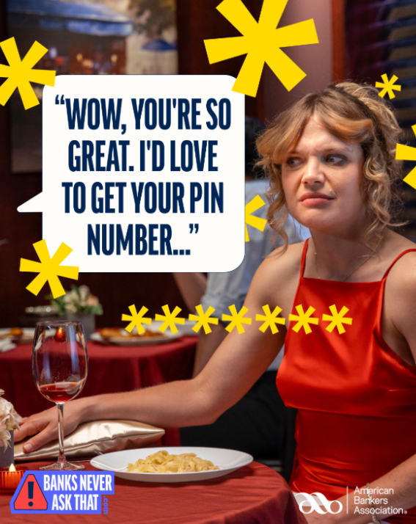
Tips to Protect Yourself and Your Family
Create a secret word or phrase with family members so you can easily verify it is indeed a family member communicating with you.
Trust your gut. If it seems too good to be true, it probably is.
#BanksNeverAskThat – don’t fall for messages that appear to be coming from your bank.
Verify, verify, verify:
Always check to be sure you aren’t falling for a scam.
Hang up and call the person’s known number directly.
Check with your bank before clicking.
Limit your online content – anything you put online can be used for impersonation/deepfake media.
Add a trusted contact to your account that the bank could contact if they suspect fraudulent activity.

Slide 9
Tips to Protect Yourself and Your Family
Watch for social engineering
This is how scammers manipulate their victims.
Regardless of the scam, they almost always share the same telltale signs:
Requests for sensitive information
Sense of urgency
Pressure to act quickly
Suspicious email addresses or phone numbers
Unusual requests from authority figures
Unexpected attachments or links
Poor grammar
Attempts to exploit your emotions such as fear or greed
Use threats (e.g., warrants for arrest) or impose other requirements to keep conversation private

Slide 10
Trust Your Local Banker
Add photo of your banker here.
If you think it might be a scam/fraud – trust your local banker. Contact your bank immediately if you suspect fraud, have questions, or are a victim of financial fraud.
Bankers see fraud every day and know what to look for.
They can help you investigate the fact pattern and protect your money.
If you fall victim to fraud, they may be able to help you recover your finances if you act quickly.
Sense of urgency – contact ASAP

Slide 11
What Can You Do?
Educate, educate, educate – this is the best way to prevent fraud
Watch for fraud and talk about the fraud you see – raise awareness, reduce the stigma of victimization and encourage reporting.
https://consumer.ftc.gov/features/pass-it-on
Report fraud to:
Your banker
CFTC.gov/LearnAndProtect
FBI’s Internet Crime Complaint Center – IC3.gov

Slide 12
Available Resources to Combat Fraud
CFPB: https://www.consumerfinance.gov/consumer-tools/fraud/
FDIC: https://www.fdic.gov/consumer-resource-center/2021-10/avoiding-scams-and-scammers
OCC: https://www.occ.gov/topics/consumers-and-communities/consumer-protection/fraud-resources/index-fraud-resources.html
#BanksNeverAskThat- https://www.banksneveraskthat.com/
Can you spot fraud? Take this quiz to find out! https://www.banksneveraskthat.com/scam-quiz/
Iowa Bankers Association Fraud Resources: https://www.iowabankers.com/services/marketing/fraud-resources/

Slide 13
Fraud Resources from Bank Here
Add fraud resources here – photos and/or content
Upcoming educational opportunities would also be appropriate here

Slide 14
Thank you
Name
Number
email
website

